Slide 1
PROBLEM 2: ATM MACHINE
GROUP 2:
Lê Võ diễm hằng ITITIU18034
Huỳnh Phương quyên
ITITIU18181
Nguyễn huỳnh phương thanh ititiu18115
Nguyễn giang ngọc trâm ititiu18158

Slide 2
PART II TRANSFER
PSEUDOCODE
Input ID and name of person to transfer. Check exist or not.
Input amount of money. If larger than , smaller or equal current balance.
Ask user continue to transfer to below ID or not. If continue, input next money.
Calculate the sum of transfer amount.
Upload new balance information after transfer of both remitter and recipient from Update.txt to ID.txt
Clear Update.txt

Slide 3
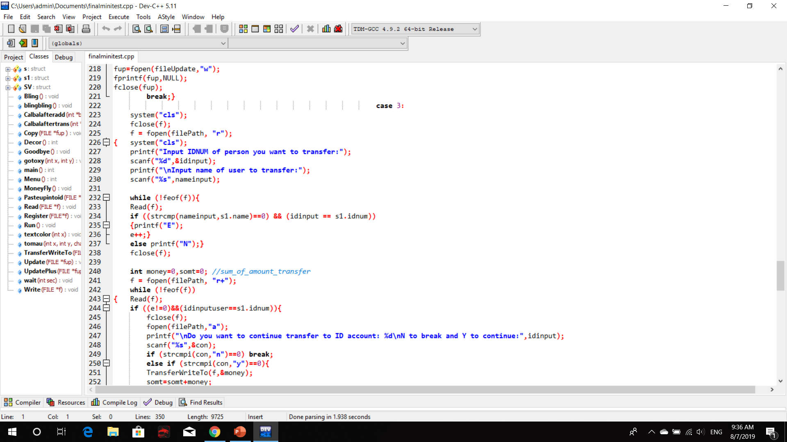
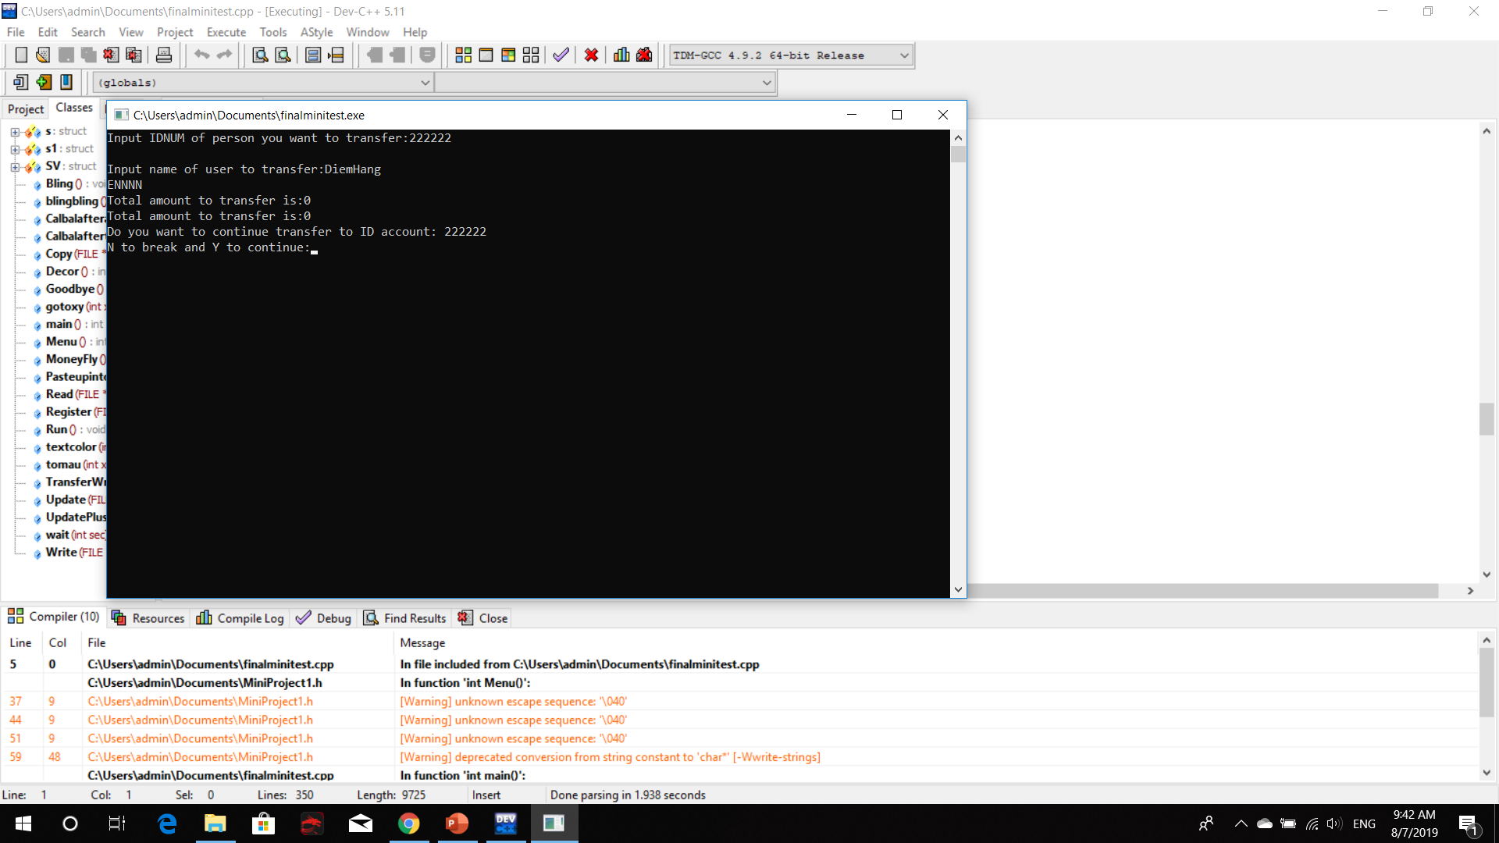
Input ID and name of person to transfer. Check exist or not.

Slide 4
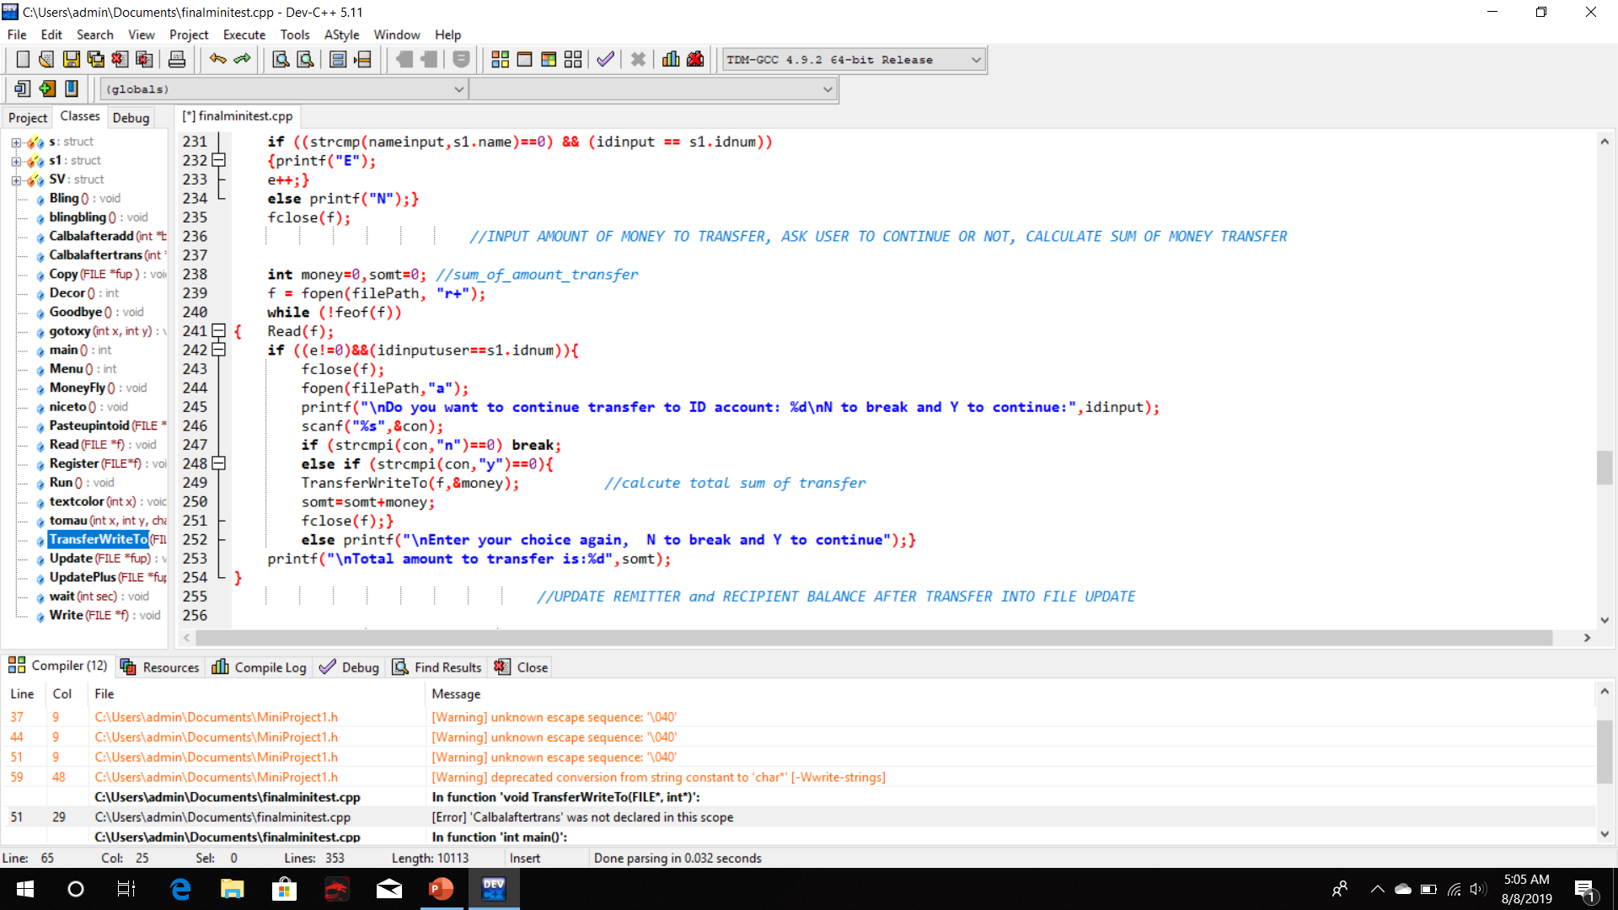
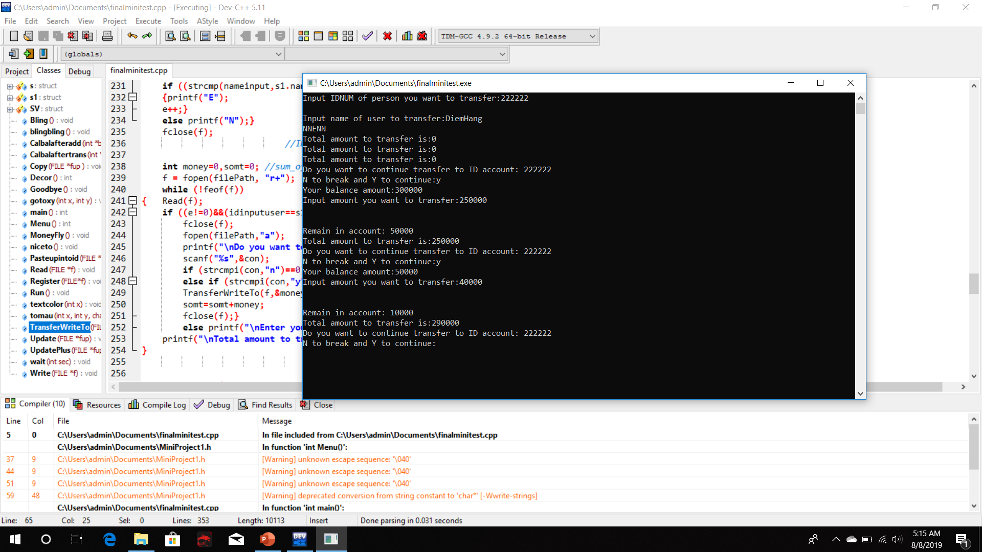
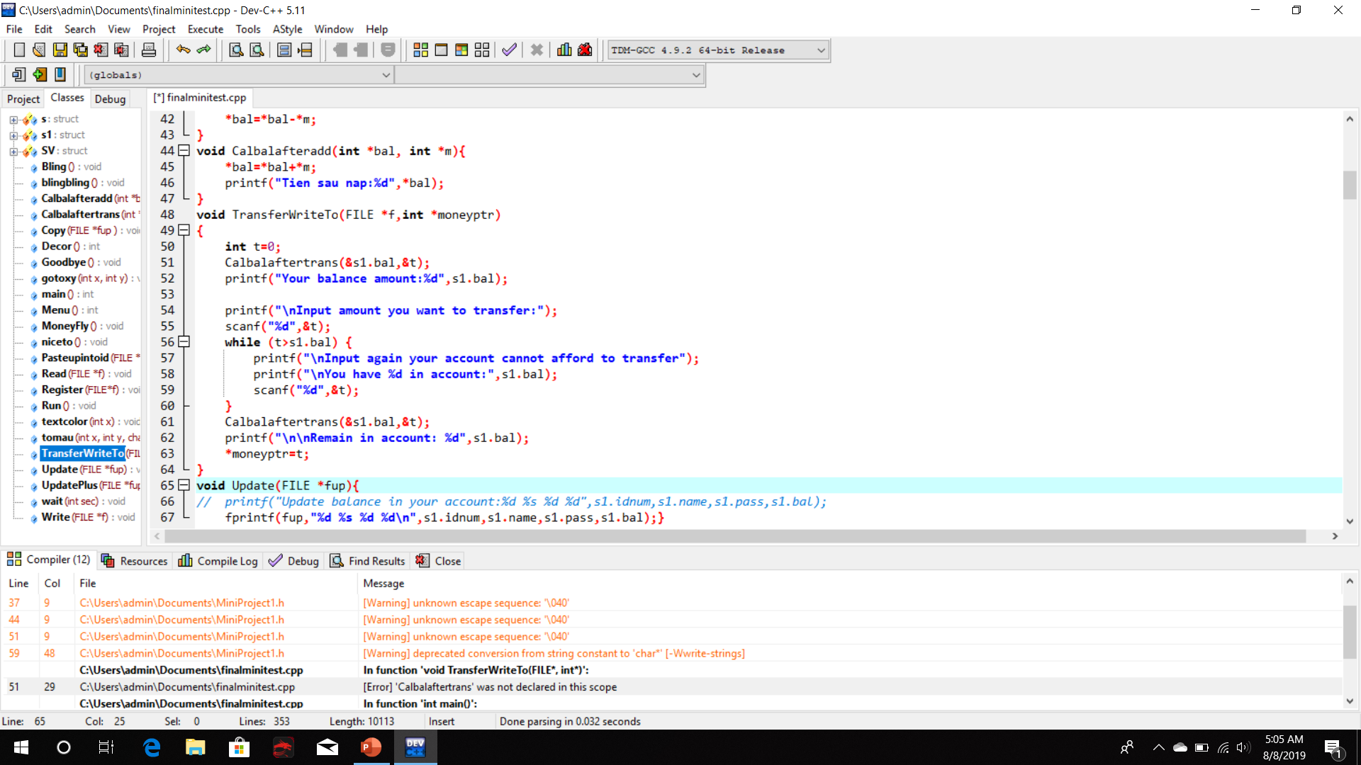
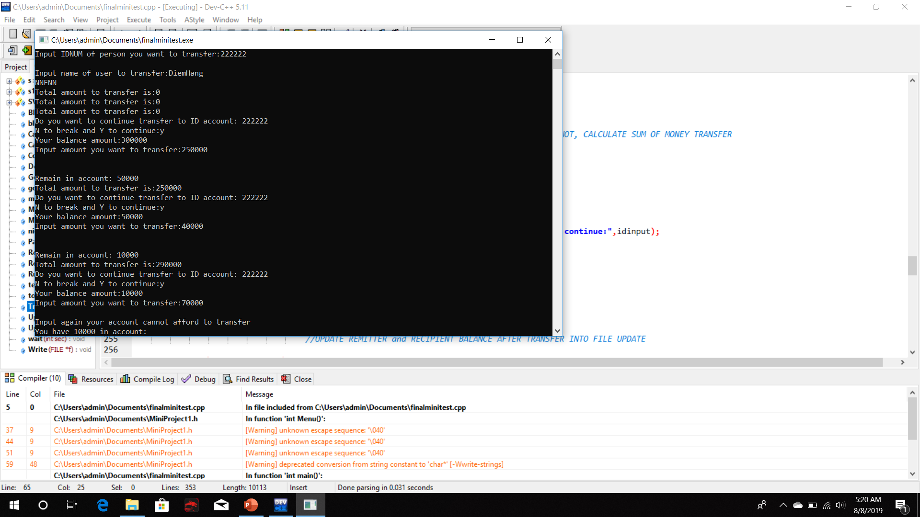
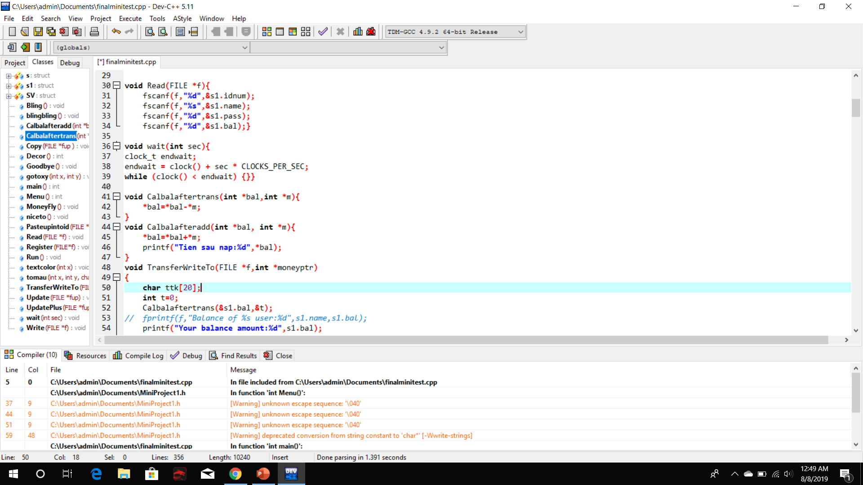
Input amount of money. If larger than, smaller or equal current balance.

Slide 5
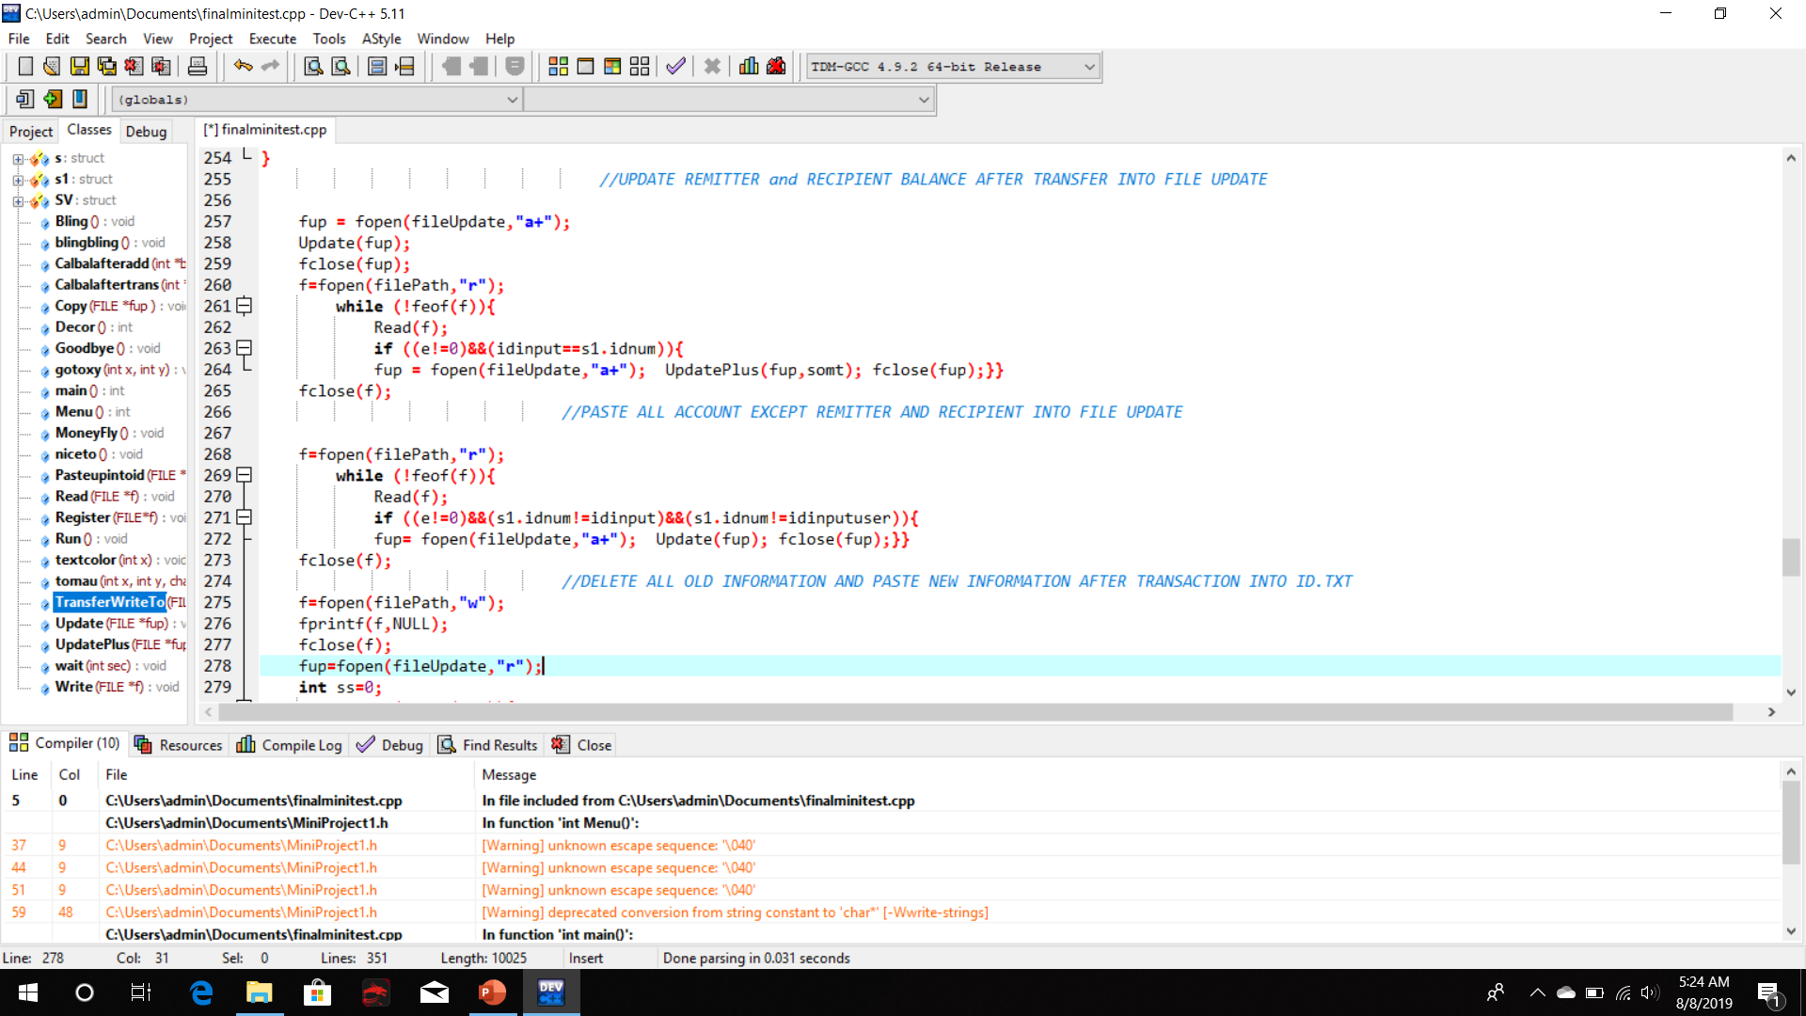
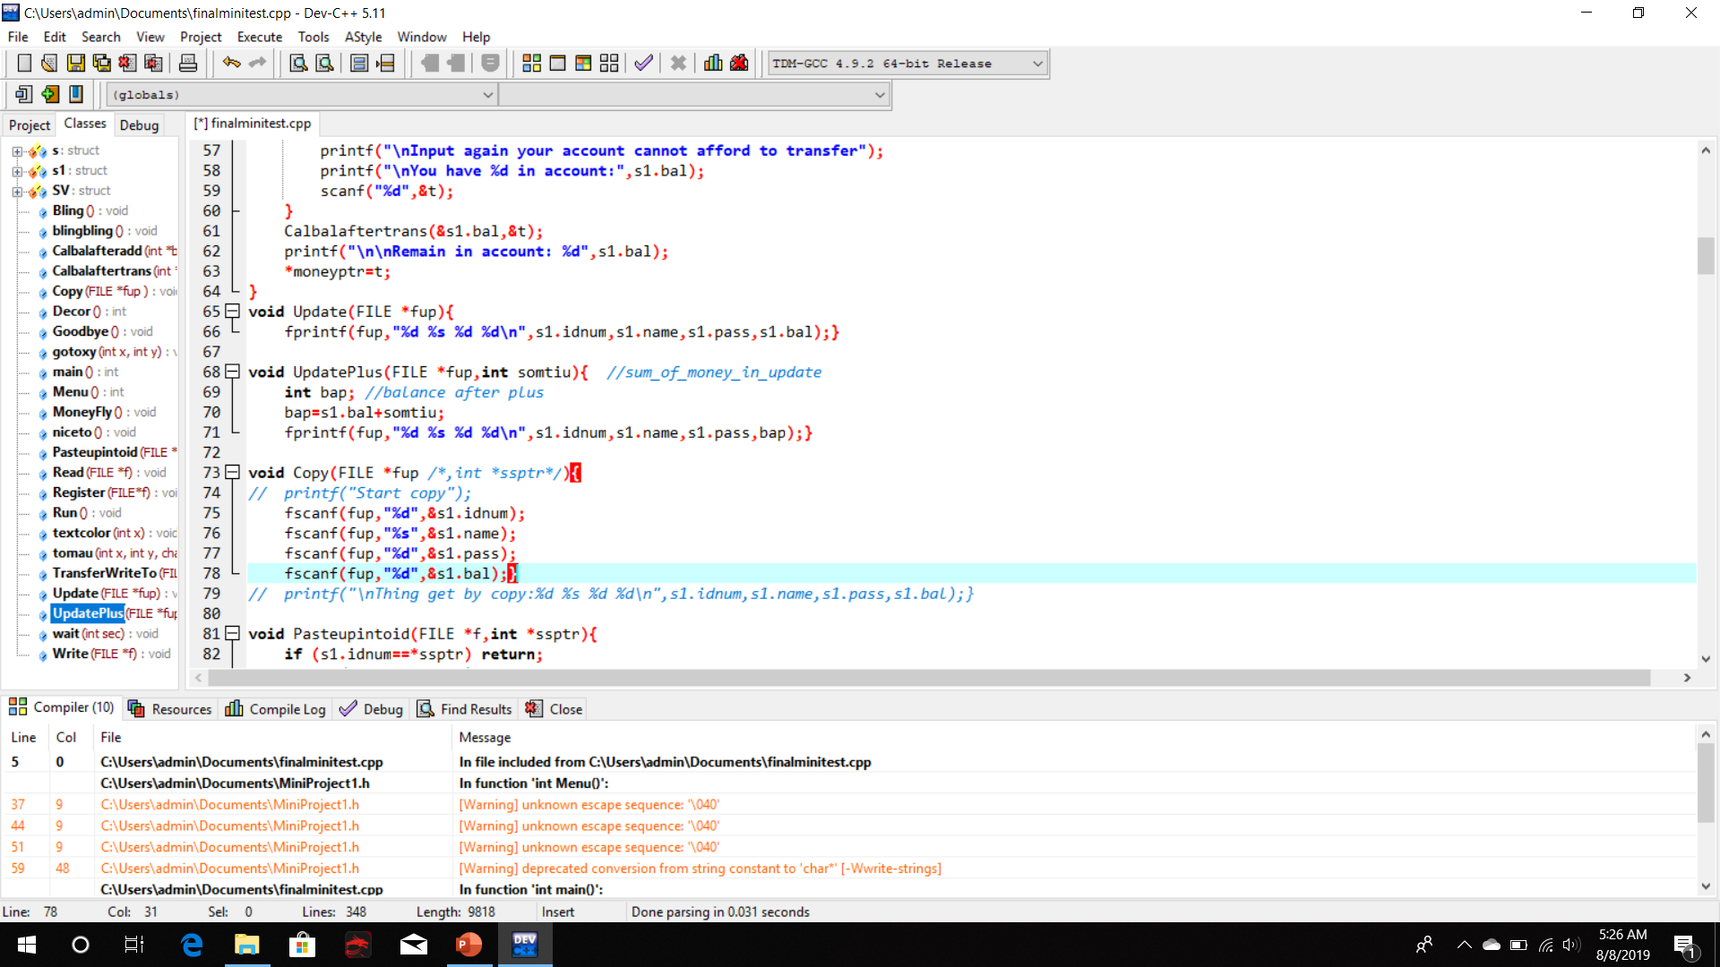
Upload new balance information after transfer of both remitter and recipient.

Slide 6
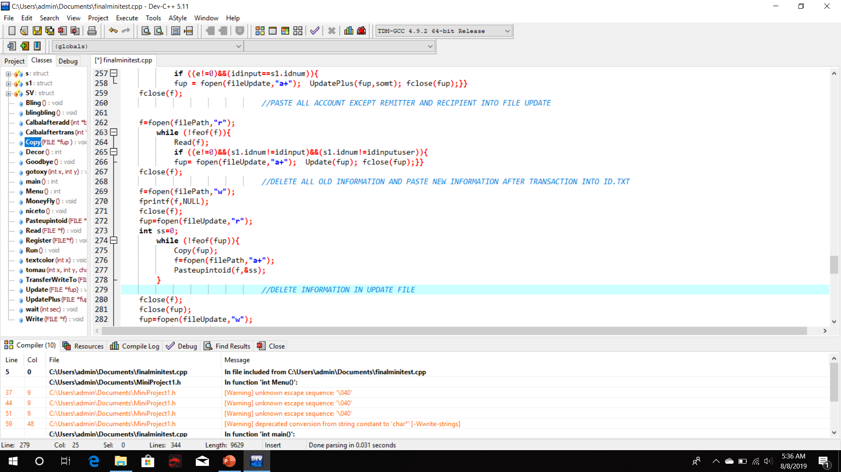
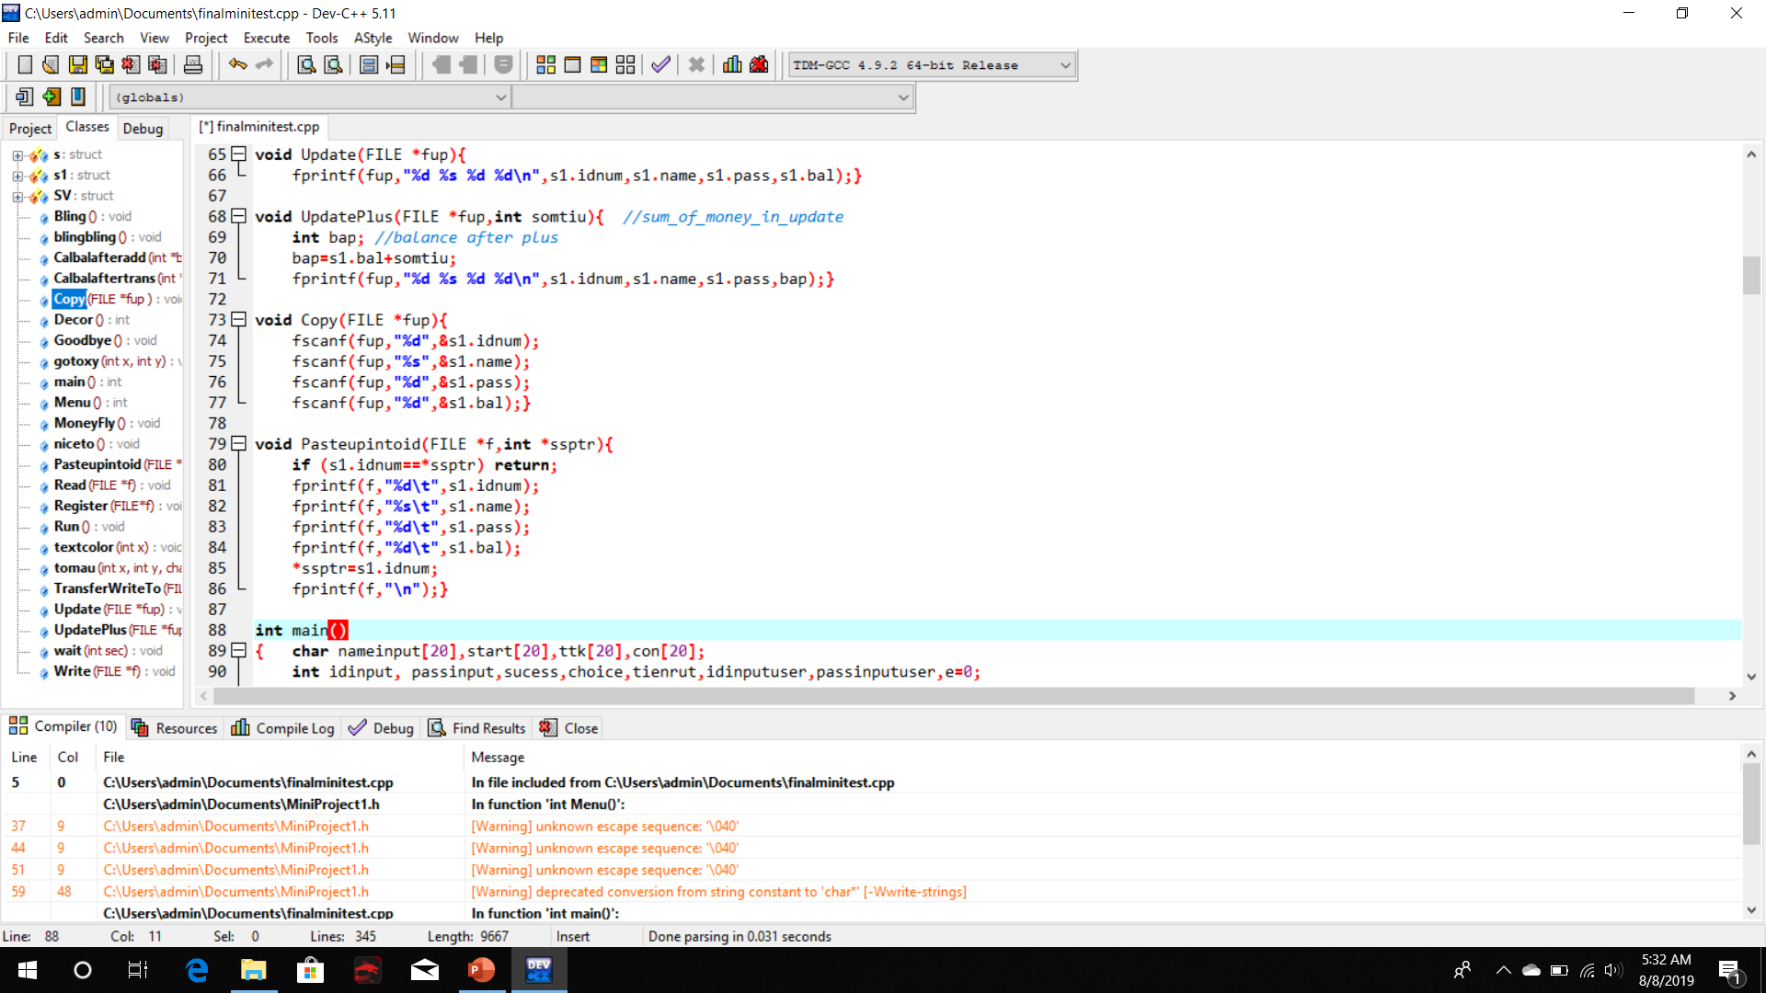
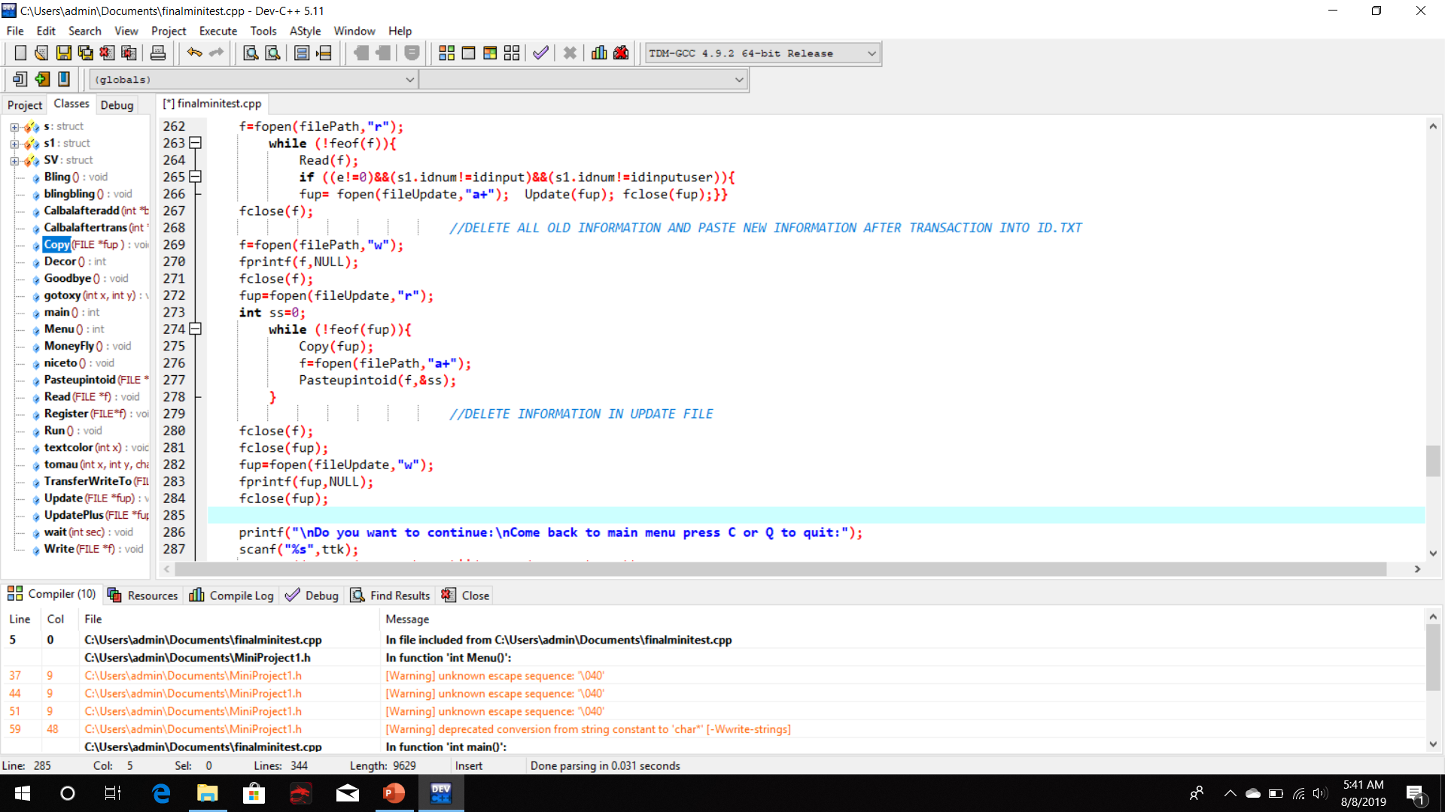
Paste new information in Update.txt into ID.txt and clear Update.txt

